Slide 1
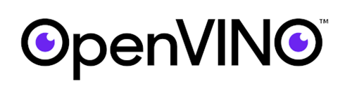
Open Visual Inferencing and Neural Network Optimization
By Yoav Raytsfeld

Slide 2

Introduction to OpenVINO Toolkit
OpenVINO toolkit
is a comprehensive toolkit for quickly developing applications and solutions that solve a variety of tasks including:
•emulation of human vision
•automatic speech recognition
•natural language processing
•recommendation systems
The toolkit extends computer vision and non-vision workloads across Intel hardware, maximizing performance. It accelerates applications with high-performance, AI and deep learning inference deployed from edge to cloud. Speeds time-to-market via an easy-to-use library of computer vision functions and pre-optimized kernels
Includes optimized calls for computer vision standards including OpenCV

Slide 3
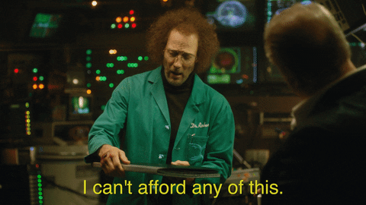
?Why OpenVINO
NVIDIA pretty much owns the market for Deep Learning. However,GPUs are expensive and not always necessary for inference. In fact, most of the inference in the world is done on CPUs! For example, Dropbox uses its CPU farm for performing OCR on documents.

Slide 4

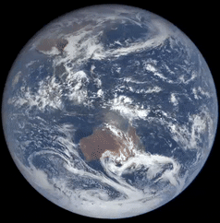
?Why OpenVINO
In the inference space, Intel is a big player. In addition to the CPUs, it manufactures Vision Processing Units (VPUs), integrated GPUs, and FPGAs — all of which can be used for inference.

Slide 5
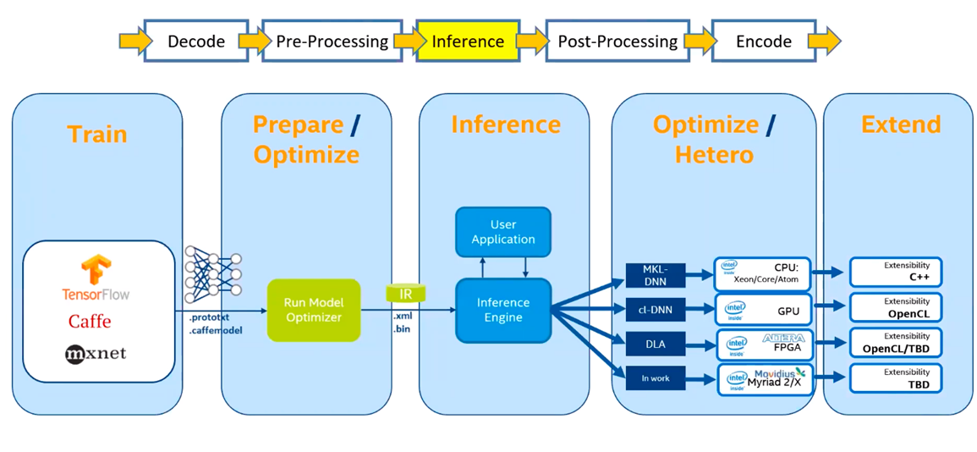
OpenVINO Toolkit Workflow

Slide 6
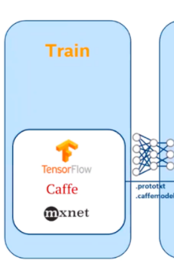
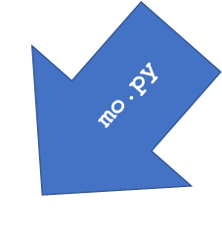
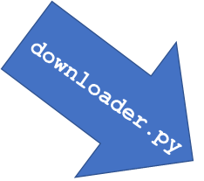
Step 1 - get a model
You can use your framework of choice to prepare and train a Deep Learning model or just download a pretrained model from the Open Model Zoo. The Open Model Zoo includes Deep Learning solutions to a variety of vision problems
Download models from
Open Model Zoo (intel/public)
converts the models
using Model Optimizer*.

Slide 7
IR files
OpenVINO toolkit introduces its own format of graph representation and its own operation set. A graph is represented with two files: an XML file and a binary file. This representation is commonly referred to as the Intermediate Representation or IR
XML file describes a network topology using <layer> tag for an operation node and <edge> tag is for a data-flow connection. Each operation has a fixed number of attributes that define operation flavor used for a nod
XML file doesn't have big constant values, like convolution weights. Instead, it refers to a part of accompanying binary file that stores such values in a binary format

Slide 8
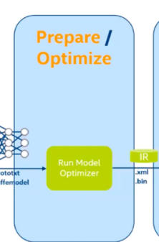
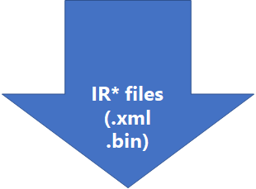
Step 2 - Model Optimizer
The Model Optimizer imports models trained in popular frameworks such as Caffe*, TensorFlow*, MXNet*, Kaldi*, and ONNX* and performs a few optimizations to remove excess layers and group operations when possible into simpler, faster graphs.
Notes:
.
XML file describes a network topology using <layer> tag for an operation node and <edge> tag is for a data-flow connection. Each operation has a fixed number of attributes that define operation flavor used for a node.
XML file doesn't have big constant values, like convolution weights. Instead, it refers to a part of accompanying binary file that stores such values in a binary format.

Slide 9
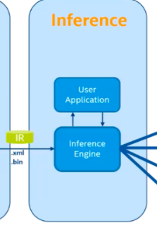
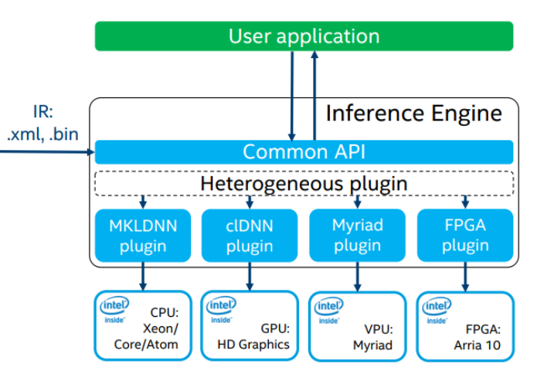
Step 3 - Inference Engine
manages the loading and compiling of the optimized neural network model, runs inference operations on input data, and outputs the results. Inference Engine can execute synchronously or asynchronously, and its plugin architecture manages the appropriate compilations for execution on multiple Intel devices, including both workhorse CPUs and specialized graphics and video processing platforms

Slide 10
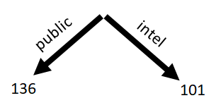
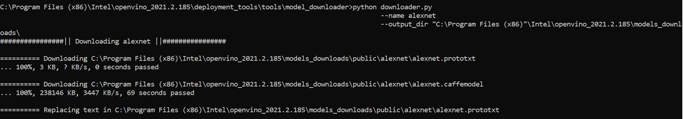
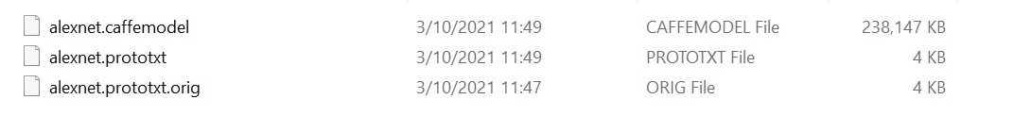
Download public model
python downloader.py --print_all
python downloader.py --name alexnet --output_dir "C:\Program Files (x86)"\Intel\openvino_2021.2.185\models_downloads

Slide 11
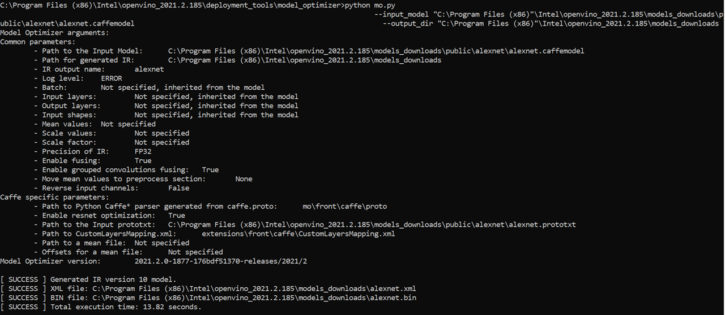
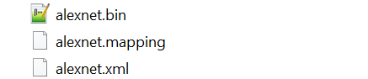
Convert

Slide 12
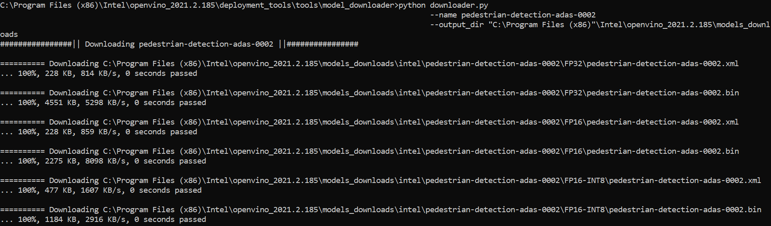
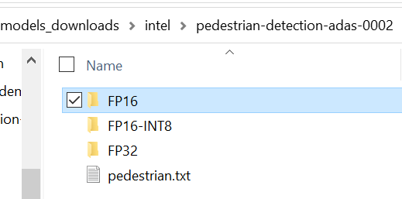
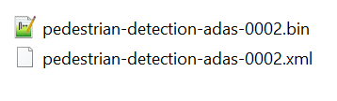
Download intel model
python downloader.py --name pedestrian-detection-adas-0002 --output_dir "C:\Program Files(x86)"\Intel\openvino_2021.2.185\models_downloads

Slide 13
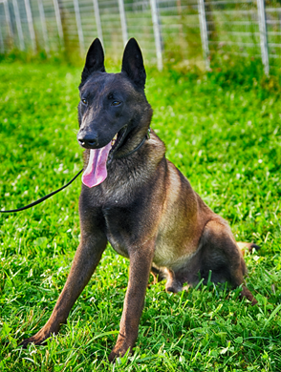
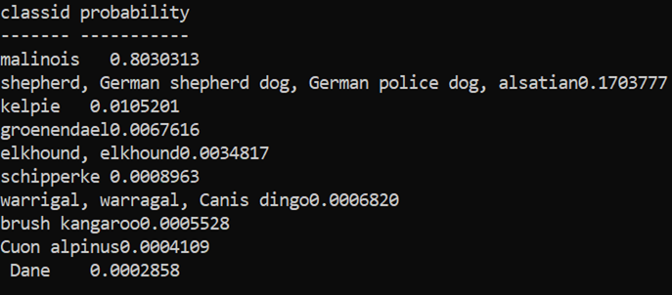
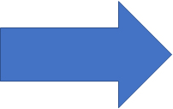
Sample 1 – Image Classification

Slide 14
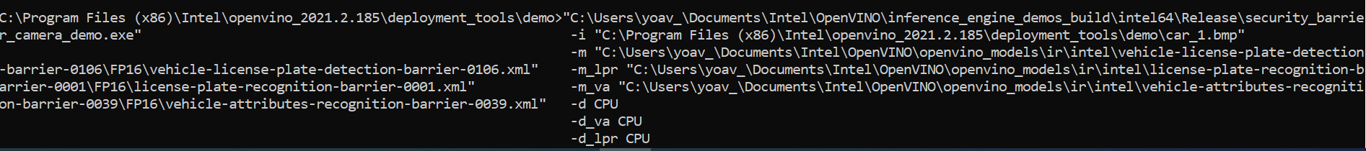
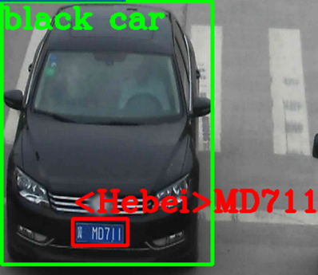
Sample 2 – multiple models in cascade
vehicle-license-plate-detection-barrier-0106.xml – detect the car and the license plate
license-plate-recognition-barrier-0001.xml – recognize characters in the license plate
vehicle-attributes-recognition-barrier-0039.xml – detect car attributes

Slide 15
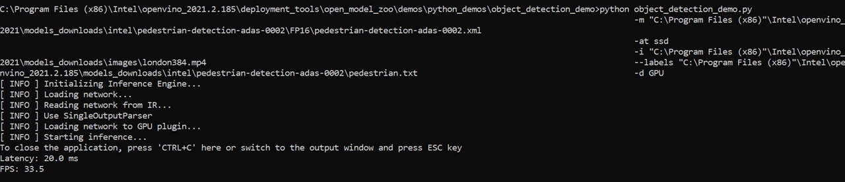
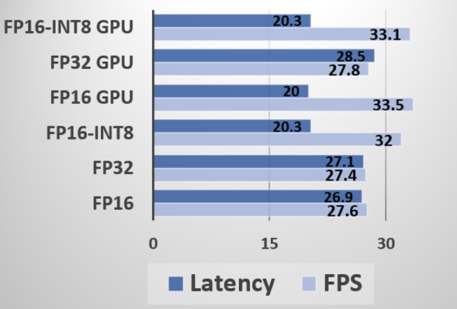
Sample 3 – video detection example

Slide 16
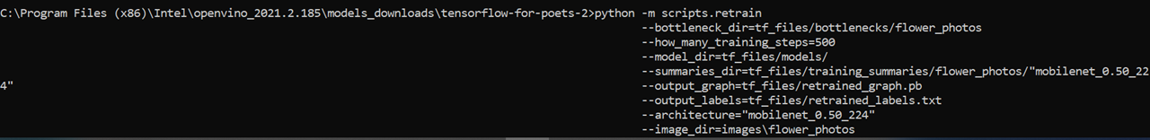
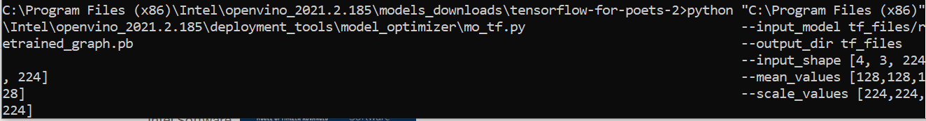
Sample 4 – transfer learning example
With easy adding parameters to the mo.py command,
you can batch the input size and scale it!
Check the full functionality with mo.py -h

Slide 17
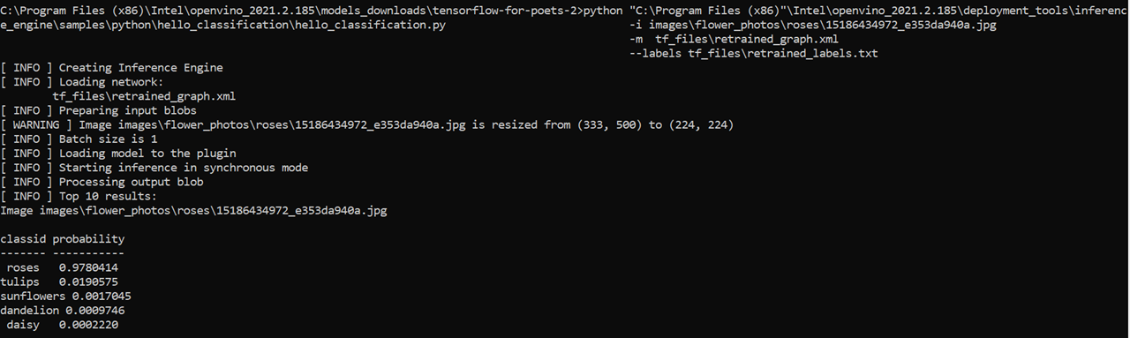

Sample 4 – transfer learning example

Slide 18
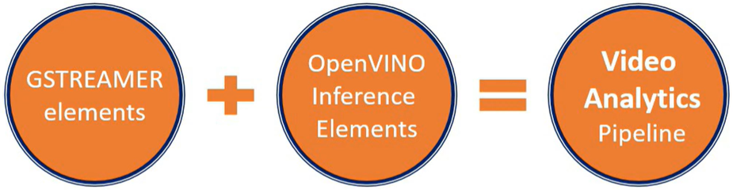
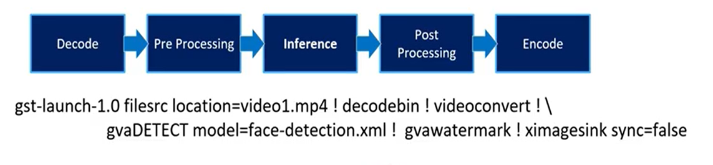
Sample 5 – interduce to GVA
GVA – gstreamer video analytics
Basically, how to add analytics elements to the pool of gstreamer elements

